Slide 1
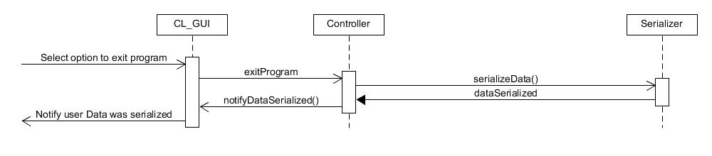

Exit Sequence Diagram
Clerk

Slide 2
Add Client Sequence Diagram
Command GUI
Theater
Client
ClientList
Asks for client’s name
Enters client’s name
Asks for client’s address
Enters client’s address
Asks for client’s phone number
Enters clients phone number
addClient(name, address, phoneNumber)
Client(name, address, phoneNumber)
Unique ID created
Clerk
client
add(client)
Client added successfully

Slide 3
Remove Client Sequence Diagram
Command GUI
Theater
Shows
ClientList
g
removeClient(clientID)
removeClient(clientID)
getClientID()
Clerk
shows.ClientID = clientID
[If shows found] Has shows listed or not
remove(client)
Client removed successfully

Slide 4
List Clients Sequence Diagram
Controller
Command GUI
Theater
Selects command to list all Clients
displayAllClientsList(theater.getClientList())
getClientList()
clientList
Lists every client
Clerk

Slide 5
Add Customer Sequence Diagram
Command GUI
Customer
CreditCard
Theater
CustomerList
CreditCardList
Asks for customer’s name
Enters customer’s name
Asks for customer’s address
Enters customer’s address
Asks for customer’s phone number
Enters customer’s phone number
Asks for customer’s credit card number and expiration
Enters credit card and expiration
Customer(name, address, phoneNumber)
Unique ID created
customer
CreditCard(number, expiration)
Clerk
CreditCard
getCustomerCreditCard(number)
getCustomerCreditCard(number)
creditCard or null
creditCard or null
[if found]Card already exists
addCustomer(customer)
add(customer)
addCustomerCreditCard(creditCard)
add(creditCard)
Customer added successfully

Slide 6
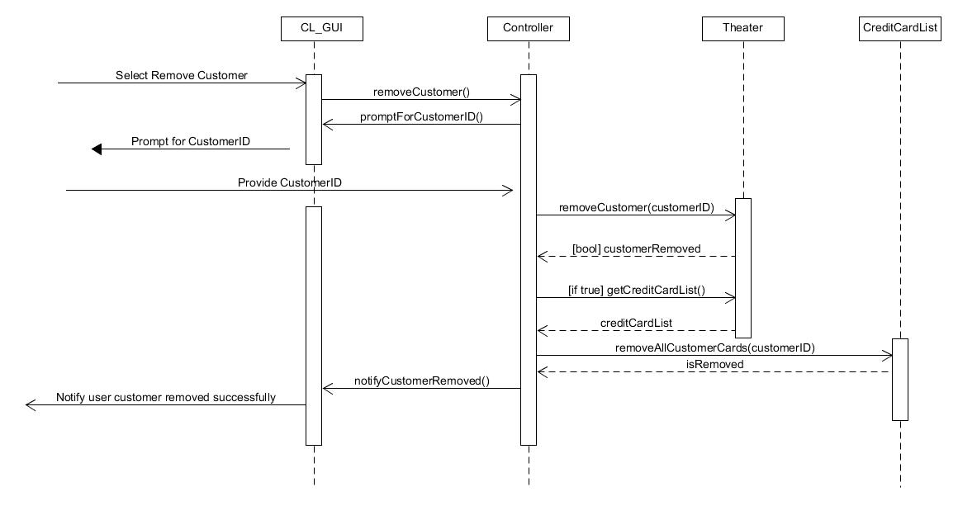
Remove Customer Sequence Diagram
Data request
Clerk

Slide 7
Add Credit Card Sequence Diagram
Command GUI
Theater
CustomerList
CreditCardList
Asks for customer ID
Enters customer ID
Asks for card number and Expiration
g
Enters card Number, expiration Date
getCustomerList()
customerExists(customerID)
[If exists = false] Customer not found
[Exists] true or false
[Exists] true or false
getCustomerCreditCard(cardNumber)
getCreditCard(cardNumber)
[Exists] creditCard or null
[Exists] creditCard or null
Clerk
[If card Exists] Card already exists
Clerk
addCustomerCreditCard(creditCard)
addCreditCard(creditCard)
Credit card added successfully

Slide 8
Remove Credit Card Sequence Diagram
Command GUI
Theater
CreditCardList
g
removeCreditCard(cardNumber)
getCreditCardList()
creditCardExists(cardNumber)
[Exists] true or false
[Exists] true or false
Clerk
[If exists = false] Card not found
Clerk
getCreditCardList()
isCustomersOnlyCreditCard(cardnumber)
[Only card] true or false
[If only card = true] Customer must have at least one card
[Only card] true or false
removeCustomerCreditCard(cardNumber)
removeCreditCard(cardNumber)
CreditCard removed successfully

Slide 9
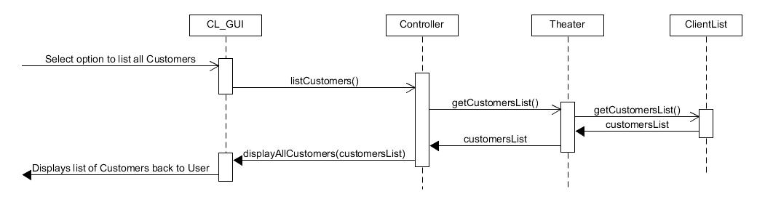
List Customers Sequence Diagram
Clerk

Slide 10
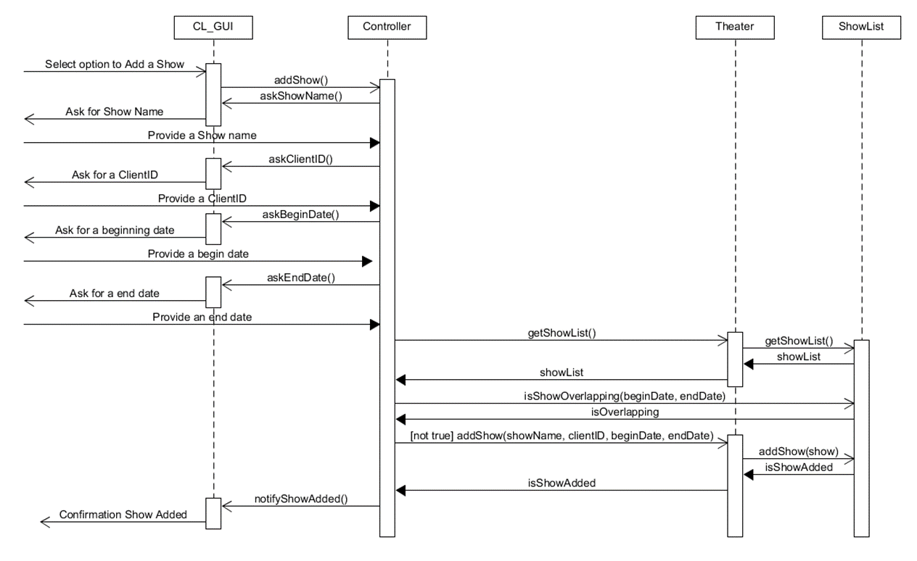
Add Show Sequence Diagram
Clerk

Slide 11
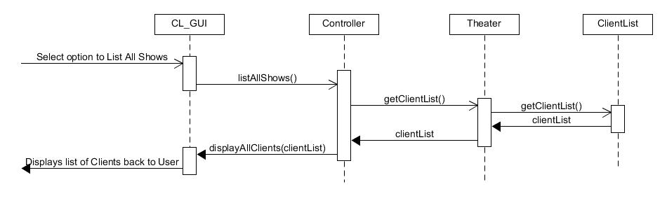
List Shows Sequence Diagram
Clerk

Slide 12
Store Data Sequence Diagram
Clerk

Slide 13
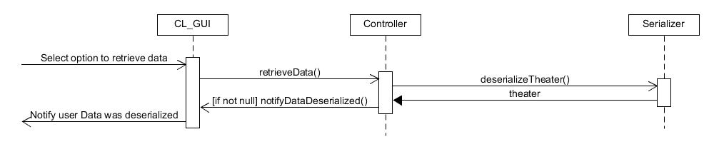
Retrieve Data Sequence Diagram
Clerk

Slide 14
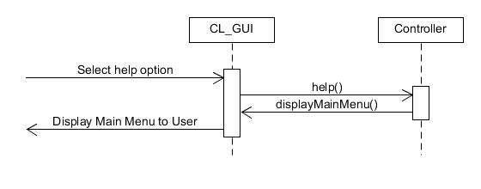
Help Sequence Diagram
Clerk

Slide 16
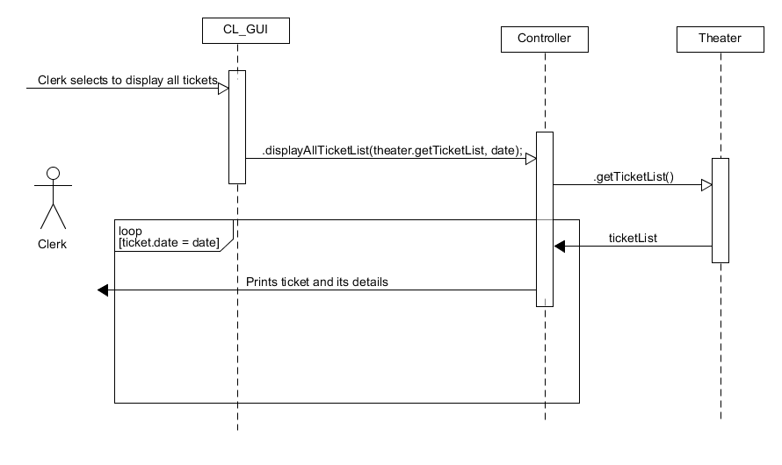
List All Ticket on certain day

